Slide 1
CAD-Coder
Deploying Diverse VLMs for CAD-Code Generation
Yuyan Fan, Jing Xu, Frank Chen, Aditya Palaparthi

Slide 2
Overview
We propose a two-phased project to deploy and advance the capabilities of Vision-Language Models (VLMs) for Computer-Aided Design (CAD) code generation. The first phase will establish a robust, deployable baseline by leveraging the publicly available, state-of-the-art CAD-Coder model, which has demonstrated superior performance in generating editable CAD code from visual inputs. The second phase will involve a focused research component to overcome current limitations, including model scalability and generalization to real-world images. We will fine-tune a range of Qwen2.5-VL models and optimize the training methodology, paving the way for a more versatile and powerful CAD automation tool.

Slide 3
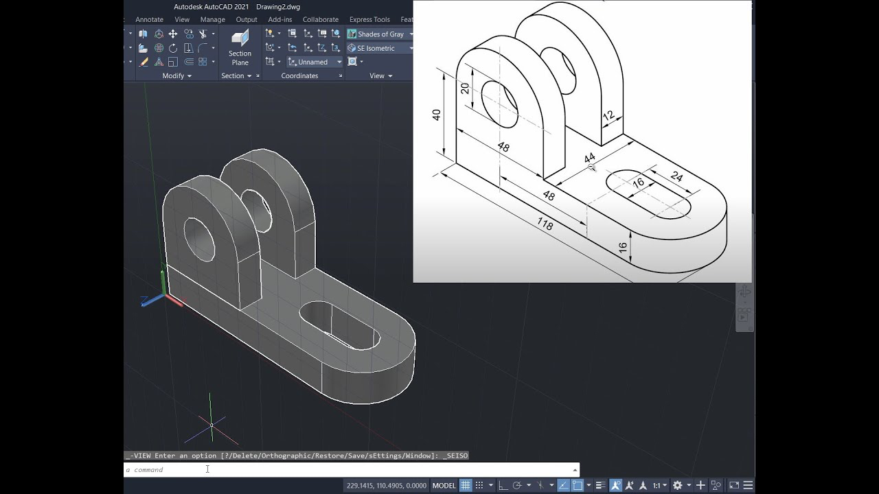
Problem Statement
The manual creation of 3D CAD models is a time-consuming and expertise-intensive process, serving as a bottleneck in engineering design and product innovation. While recent AI-driven solutions show promise, they often suffer from key limitations:
Lack of Generalizability: Existing models often fail when faced with real-world images or when asked to perform CAD operations not explicitly seen during training.
Non-Editable Outputs: Many generative models produce non-editable formats like meshes or voxels, which are impractical for real-world engineering applications that demand modifiable designs.
Limited Accuracy: Prior fine-tuned models can produce syntactically incorrect code, and off-the-shelf VLMs often hallucinate incorrect geometry or produce code with errors, limiting their reliability

Slide 4
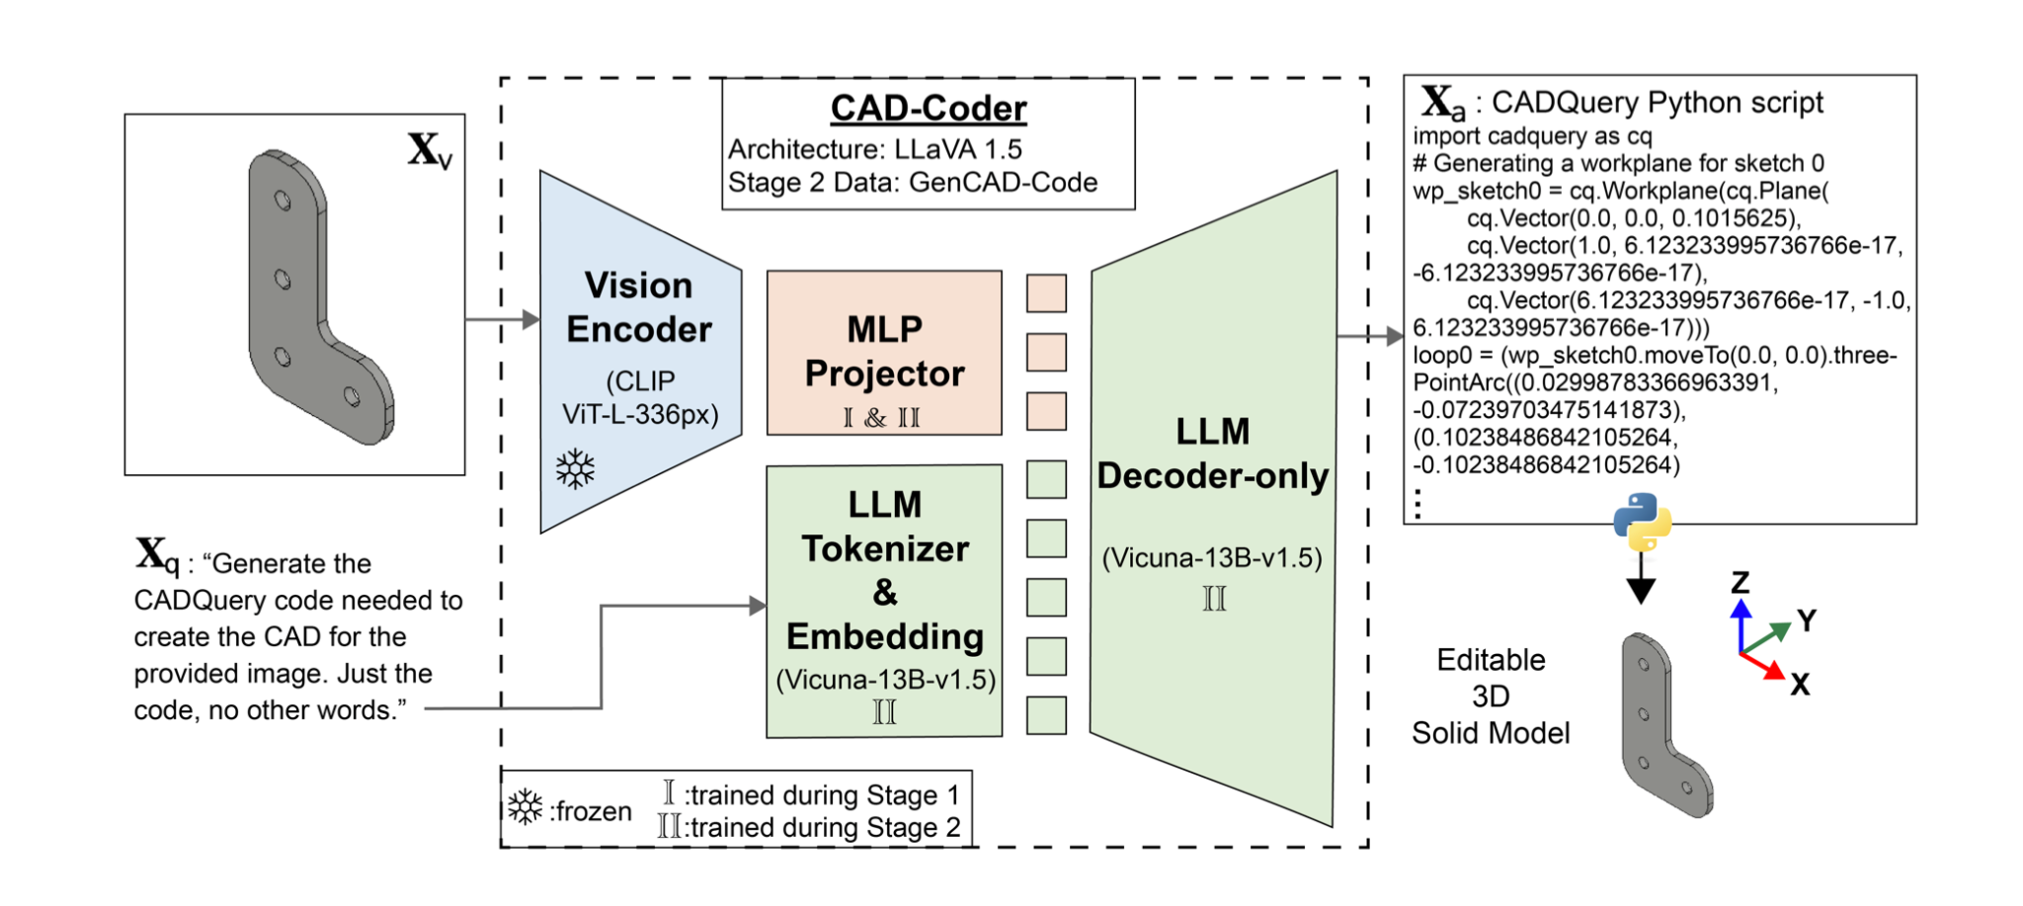
CAD-Coder Architecture
Or Point Clouds

Slide 5
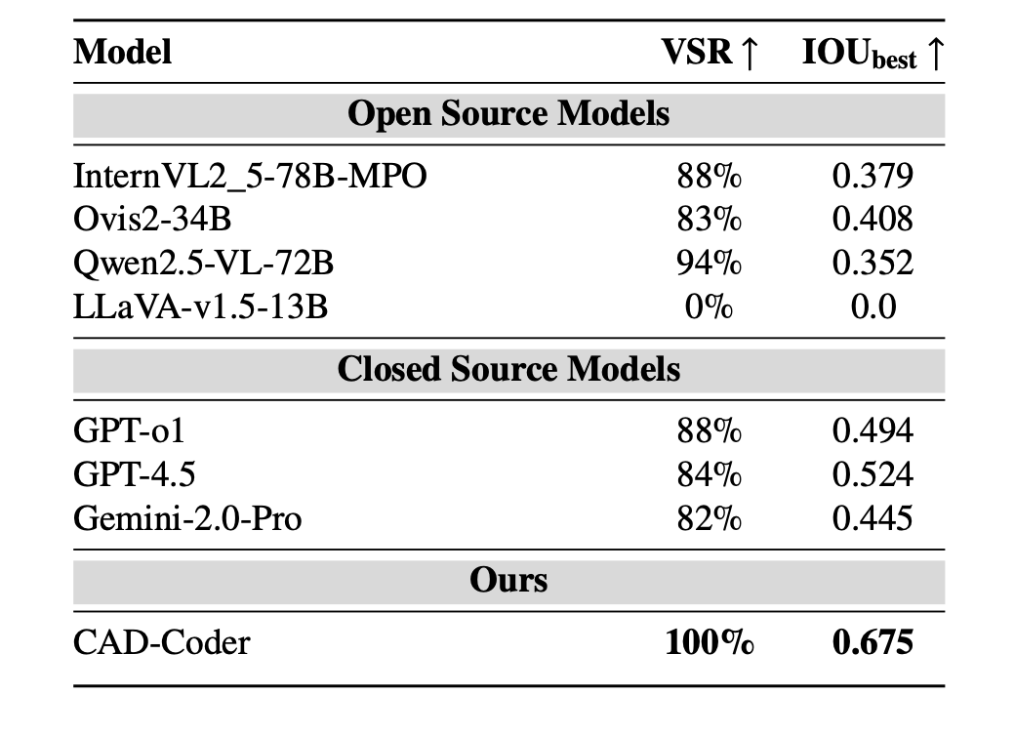
VSR = SYNTACTICALLY-VALID
CADQUERY SCRIPTS
ACCURACY OF THE
RESULTING 3D SOLIDS (IOU_best)

Slide 6
Proposed Solution
Phase 1: Deployment & Baseline Establishment
Deploy CAD-Coder: We will deploy the open-source CAD-Coder model, which has a proven track record of generating a 100% valid syntax rate and achieving the highest geometric accuracy (IOUbest​) compared to other state-of-the-art VLMs like GPT-4.5 and Qwen2.5-VL-72B.
Leverage GenCAD-Code Dataset: The model will be deployed using the public GenCAD-Code dataset, which contains over 163,000 pairs of CAD images and their corresponding CadQuery Python code. This dataset is the largest of its kind and is crucial for the model's performance

Slide 7
Proposed Solution Continued
Phase 2: Advanced Research & Development
We will explore fine-tuning strategies for a range of Qwen2.5-VL models.
Objective 1: Model Optimization and Scalability
  Hypothesis: A larger, more powerful VLM, if properly fine-tuned, can achieve even better performance and generalization than CAD-Coder.
  Methodology: We will fine-tune a series of open-source Qwen2.5-VL models in different sizes, including the 3B, 7B, 14B, 32B, and 72B variants. This will allow us to find the optimal balance between performance and computational cost.
  Address Hardware Constraints: To mitigate memory issues with the larger models, we will investigate and implement advanced fine-tuning techniques like LoRA (Low-Rank Adaptation) and QLoRA (Quantized LoRA), which significantly reduce the memory footprint by training only a small portion of the model's weights while keeping the base model frozen

Slide 8
Proposed Solution Continued
Phase 2: Advanced Research & Development Continued
Objective 2: Enhanced Generalization
Hypothesis: By tuning hyperparameters and training for more epochs, we can preserve the model's pre-trained knowledge, improving its ability to handle unseen tasks.
Methodology: We will move beyond the single-epoch training used in the original paper to explore the effects of training for more epochs. We will also perform hyperparameter tuning on the learning rate and effective batch size. The original paper's findings showed that a lower learning rate during fine-tuning helped a Qwen-based model retain knowledge of unseen CAD operations, though it came with a performance trade-off. We will systematically investigate this trade-off to find the sweet spot for generalizability.
Real-World Image Capability: We will explore methods to improve the model's ability to infer precise dimensions and proportions from real-world images with varying perspectives, a known limitation of the current model

Slide 9
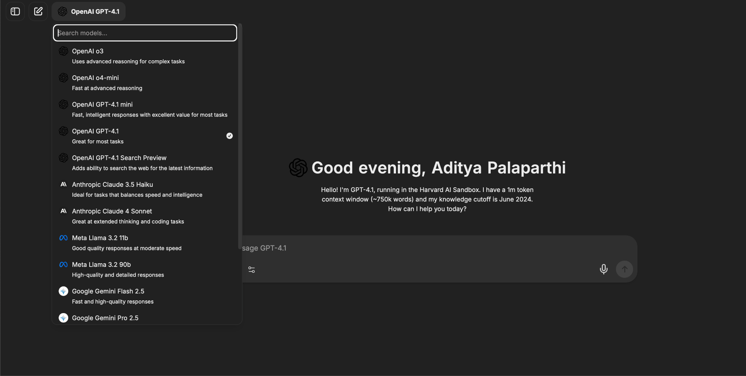

Slide 10
Technical Plan & Resources
Hardware: The project will be executed using 4 x 80 GB A100/H100 GPUs, providing the necessary computational power and memory to train and experiment with large-scale VLMs.
Dataset: We will primarily use the GenCAD-Code dataset (hosted on GitHub), which is also available on Hugging Face, to ensure a standardized and reproducible fine-tuning process.
Methodology: We will follow a two-stage training approach similar to the CAD-Coder paper, which aligns the vision encoder's features with the LLM's word embeddings before end-to-end supervised fine-tuning. We will specifically track
Valid Syntax Rate (VSR) and IOUbest​ to quantitatively measure our progress

